Slide 1
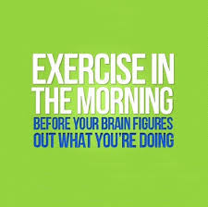

Slide 2
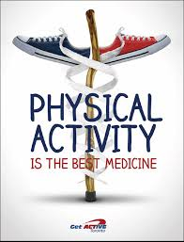
Our passion …

Slide 3
Did you know that after physical activity your brain is better prepared for learning?

Slide 4
From the research, we know that physical activity helps us to …
Deal with stress
Be more focused
concentration
Be calmer
Stay on task
Sleep better

Slide 5
Anxiety and stress have been found to raise the levels of hormones such as cortisol, which can actively interfere with learning (Ratey, 2008).
Alternatively, being active outdoors in a natural environment has been shown to relieve stress and activate more areas of the brain
Selhub & Logan, 2012

Slide 6
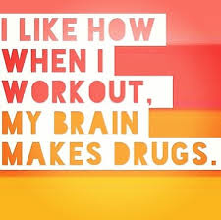
Endorphins … the happy hormones
When we exercise Endorphins are released in the brain … “feel good” hormones
Acts as a very powerful long term anti-depressant
An interesting fact: after moderate exercise, a greater amount of endorphins are released than with light or vigourous exercise
Dinas PC, Koutedakis Y, Flouris AD (2011). "Effects of exercise and physical activity on depression". Ir J Med Sci 180 (2): 319–325.

Slide 7
More “drugs” in the Brain …
According to Ratey (2008), aerobic exercise serves to increase the levels of dopamine, serotonin and norepinephrine in the brain (pp. 36-38).
These neurotransmitters help to increase focus, decrease impulsivity, and serve to calm subjects and relieve stress
Mead, Morley, Campbell, Greig, McMurdo & Lawlor, 2008

Slide 8
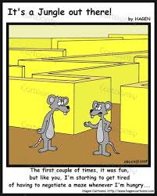
What would research be without MICE?
In a study using mice, running has been shown to increase the production of new neurons in the hippocampus, a brain structure that is important for memory function.
Less fit mice were unable to find an escape route from a maze when compared with those mice who were housed with a running wheel and, therefore, were more active.
The more active mice were easily able to find the new escape route, demonstrating an improved ability to learn.
Van Praag, Christie, Sejnowski & Gage, 1999

Slide 9
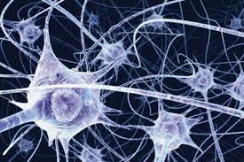
Neurogenesis … What?
It was once thought that new neuron growth was not possible, but recent brain imagery has shown that the human brain generates new neurons

Slide 10
More on MICE!
Exercise causes increased production of brain-derived neurotropic factor (BDNF).
This chemical fuels brain activities leading to higher thought processes
It has been demonstrated in mice that a brain low in BDNF shuts down cognitively to new learning
Vaynman, Ying, & Gomez – Pinilla, 2003

Slide 11
Neuron Activation

Slide 12
What’s new in Research at
I was interested in the effects of physical activity and student engagement
Notes:
At the Faculty of Education we have graduate students working on a wide variety of research projects as part of their M.Ed. requirements.

Slide 13
From the research we already know …
Increased Student Engagement
Increased Student Achievement

Slide 14
The Research Question …
What is the impact, if any, of a morning physical activity intervention on individual student and whole classroom engagement as measured by teacher and educational assistant observations and perspectives?

Slide 15
What was the Methodology
1 school in study
was already participating in the Active Start Program
Whole school active every morning for the 1st 15 minutes of the day
Was followed by a literacy period

Slide 16
More on Methodology …
8 classes, 4 randomly selected
students from each class
2 weeks no activity
2 weeks activity
Grades 1 through 6
qualitative data(interviews with
teachers and EA)
quantitative data (daily observation
ratings of student participant behaviours)

Slide 17
So what did we find?
Both quantitative and qualitative results revealed that during the physical activity portion of the study, students were much more engaged in the learning process than during the two weeks of non activity

Slide 18
The “So What” of the Research …
The results of this study support the premise that physical activity before academic activity increases engagement in many students through increased calm, focus and attention

Slide 19
University of Manitoba MSpace
Relationship Between Morning Physical Activity and Engagement in an Elementary School Setting
Entire thesis can be accessed through MSpace under Author: Cheryl Kathleen Isaac

Slide 20
http://activestartpembinatrails.weebly.com

